Slide 1
Introduction to Computers, Problem Solving and Programming
COS 1020 C++ Programming
AUBG COS Department
Based on chapter 1 – problem solving, abstraction and design using C++, Friedman & Koffman

Slide 2
Lecture Contents
1.1 Anatomy of Computers
1.2 Processing a High-Level Language Program
1.3 The Software Development Method
1.4 Applying the Software Development Method

Slide 3
Anatomy of Computers
Hardware – the physical components of a computer
  CPU, Main Memory (RAM), Secondary Memory (Disk, CD)
  Input Devices – Keyboard, Mouse
  Output Devices – Monitor, Printer
Software – the set of programs associated with a computer
Program – the list of instructions that the computer uses to perform operations with the data

Slide 4
Programming Languages
Software instructions are written in a programming language
Low-level languages – Machine language, Assembly language
  Contain numbers and mnemonic codes
  Directly understood by a computer
  Not standardized – every CPU has a different machine language
  Hard for humans to understand
High-level languages – C, C++, C#, Java
  Combine algebraic expressions and English words
  Easy to understand

Slide 5
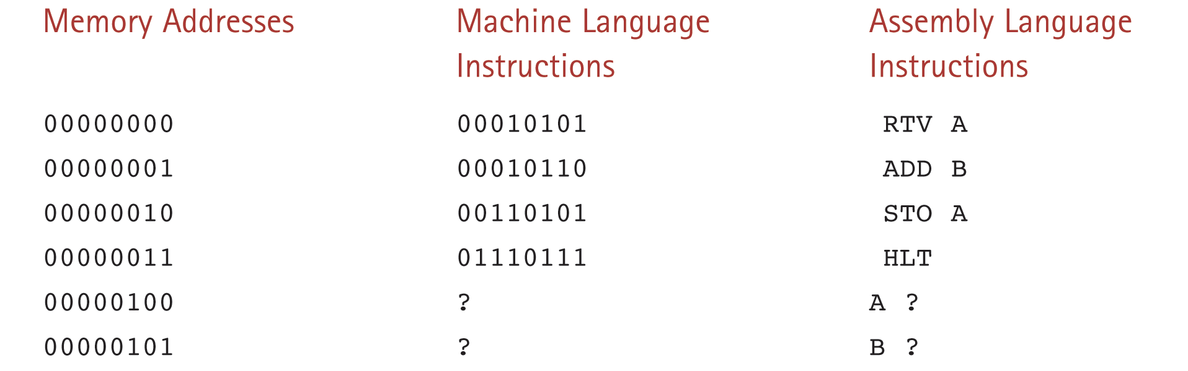
A Program in Machine and Assembly Language

Slide 6
High-level Languages
The program fragment from the previous slide, written in a high-level language would be:
  a = a + b;
Much more compact and readable than machine and assembly languages
Must be translated into machine language in order to be executed

Slide 7
Processing a High-level Language Program (Part 1 of 2)
Computers do not understand programs written in high-level languages. To be executed, such programs must be translated into the target computer’s machine language
Compiler
  Takes a source file, containing the text of the program. Source code is usually entered by the developer through a text editor
  Creates an object file with the machine language instructions that carry out the commands in the high-level source program

Slide 8
Processing a High-level Language Program (Part 2 of 2)
Linker
  Combines object files to create a executable program
  The target program is saved on the disk and is ready to run
Loader
  Copies an executable machine language program into memory and starts its execution

Slide 9
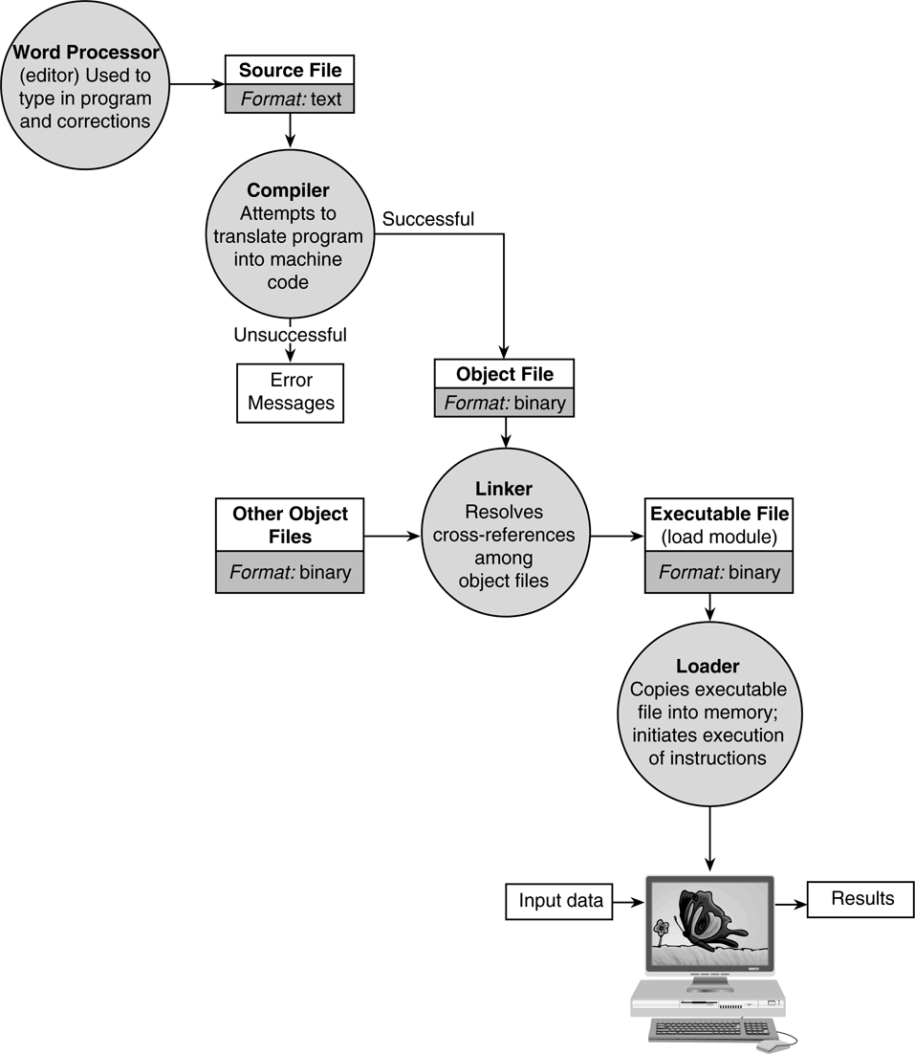
Preparing a
High-level Language Program for Execution
Entering source code
Compiling
Linking
Loading

Slide 10
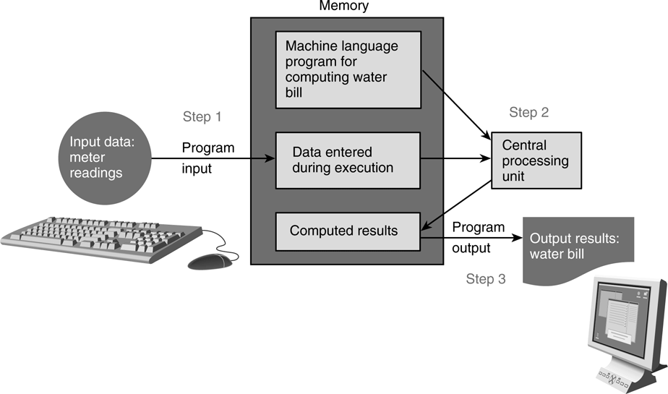
Flow of Information During Program Execution

Slide 11
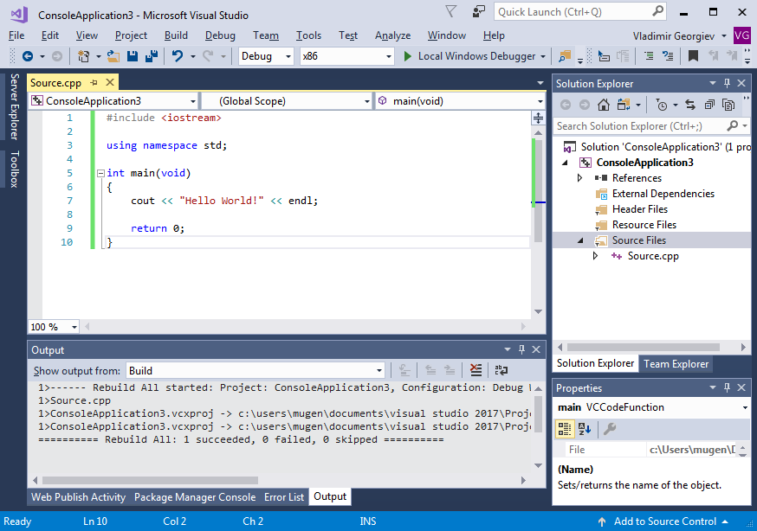
Integrated Development Environments (IDEs)
Combines a source code editor with a compiler, linker and a loader.
Popular C++ IDEs:
  Visual Studio
  Code::Blocks
  Eclipse

Slide 12
Exercise: Creating a C++ Program
Problem:
  Create a program that will print your name on the screen using the Visual C++ IDE.
  The program must print a message like the following:
    Hello John Smith!

Slide 13
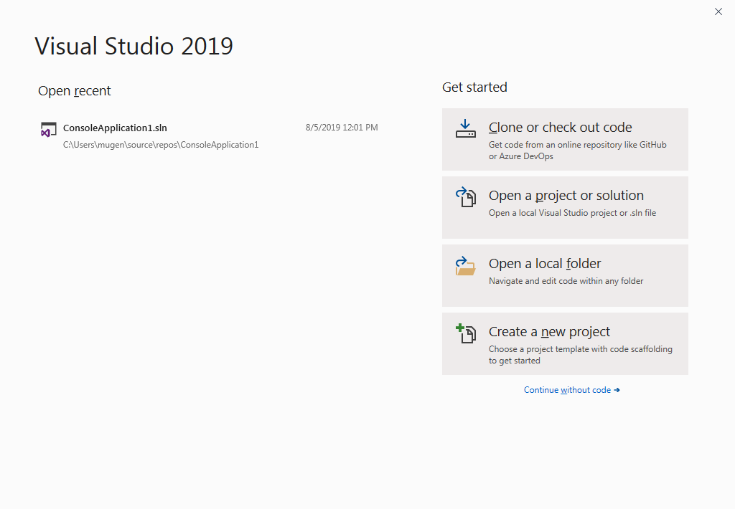
Step 1: Creating the Project (1 of 2)
Start Microsoft Visual Studio
Click “Continue without code”
From the top menu, click:
File > New > Project
Select C++ as Language
Click on Console App

Slide 14
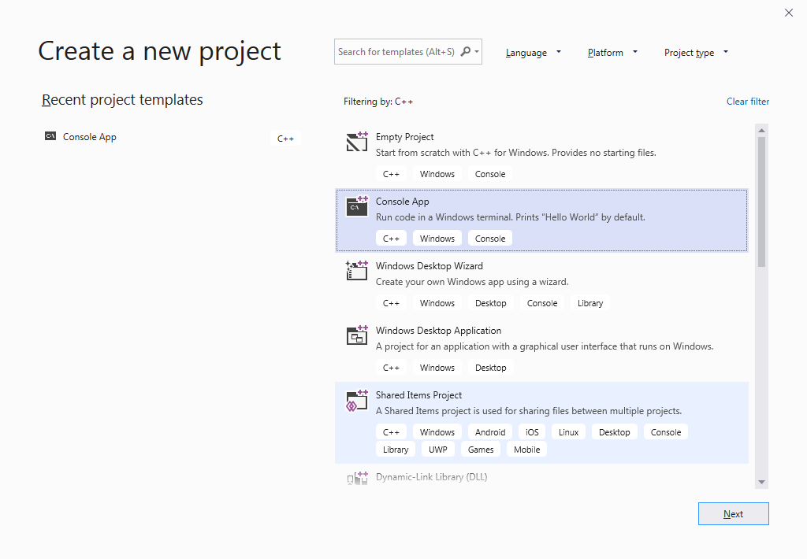
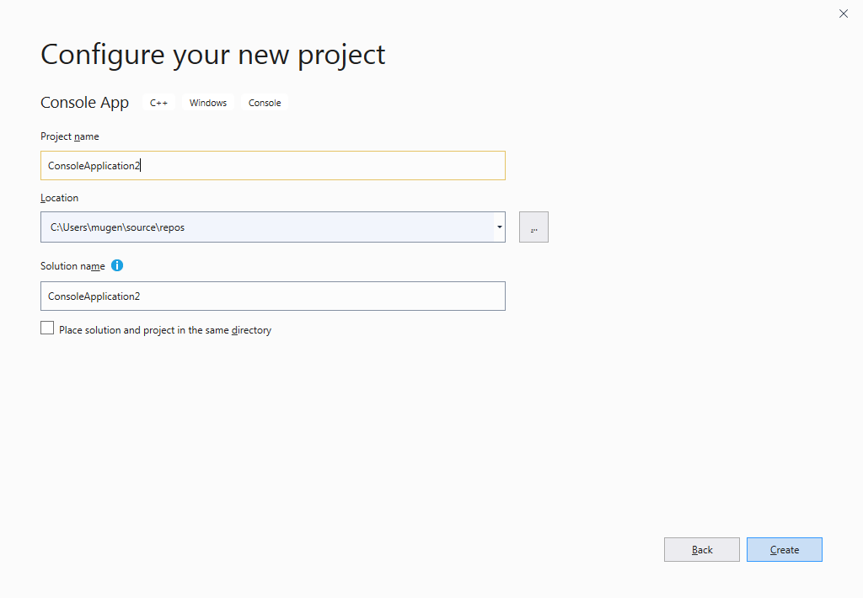
Step 1: Creating the Project (2 of 2)
Click Next.
Check the Location and click Create.

Slide 15
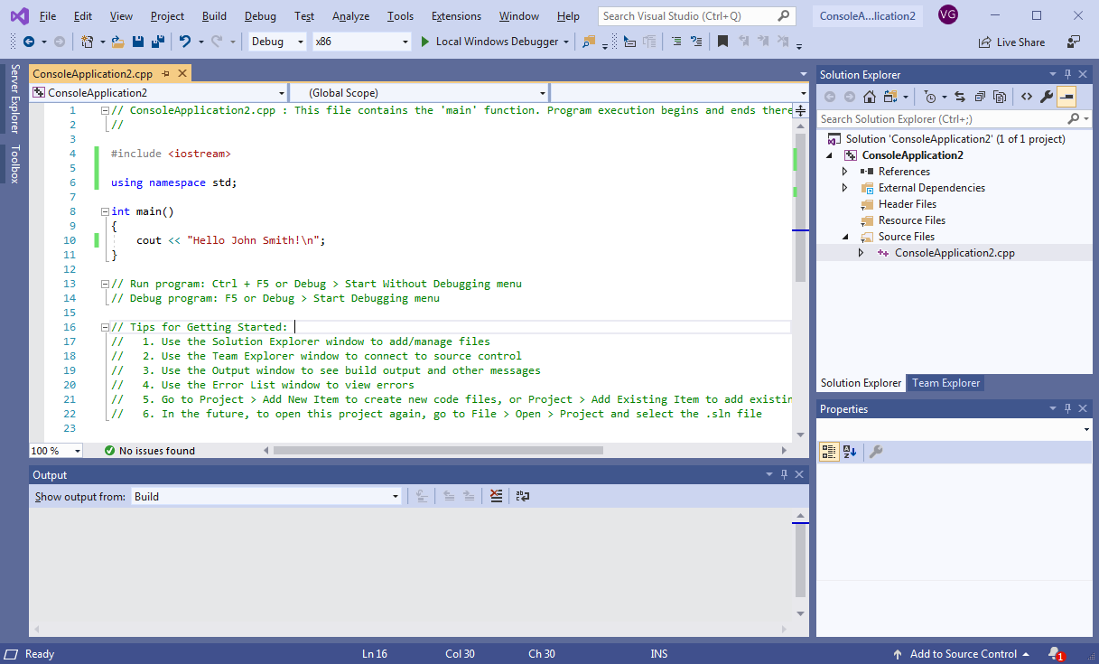
Step 2: Writing the Code

Slide 16
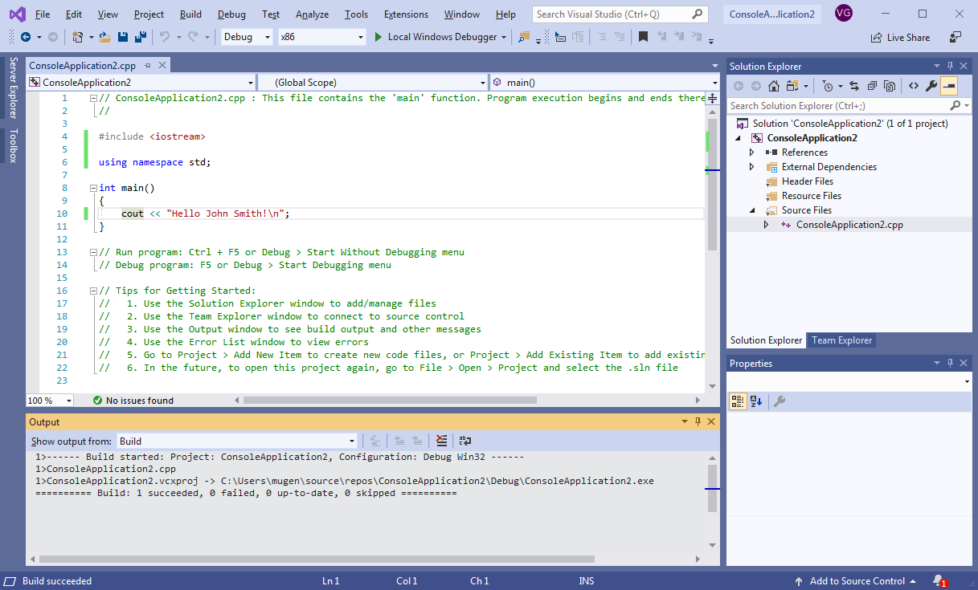
Step 3: Building the Program
Build the program by clicking the Build > Build Solution on the top menu.
If there were errors, they will be shown in the Error List bottom tab.

Slide 17
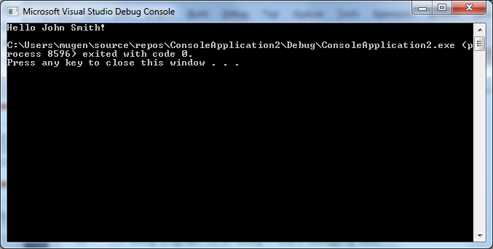
Step 4: Running the Program
Run the program by clicking Ctrl + F5
You should see a window similar to the one on the right – containing the output of your program.

Slide 18
Object-Oriented Programming
C++ was developed in 1980s as an extension of the C language
Popular because makes it easier to reuse and adapt existing code
  Classes – define properties of entities (e.g. Vehicle)
  Objects – instance of a class (e.g. FordGT)
  Methods – operations to be performed on objects (e.g. Move)
Organized in a hierarchy
  Sub Classes
  Super Classes

Slide 19
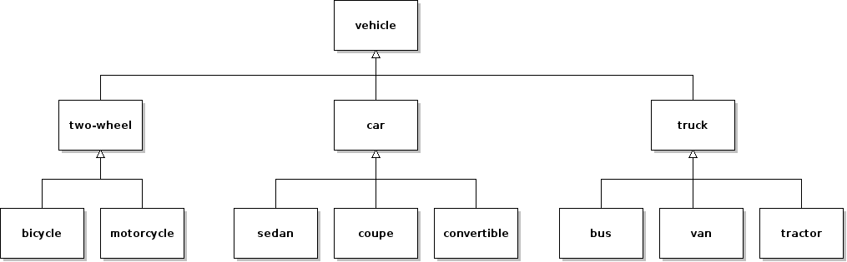
Class Hierarchy Example

Slide 20
Object-oriented Principles (Part 1 of 2)
Encapsulation
  Hiding implementation details by restricting access to methods and data.
Abstraction
  Extracting the important properties of an object, while ignoring inessential details.
NOTE: Encapsulation and Abstraction are closely related and they are used for reducing system complexity.

Slide 21
Object-oriented Principles (Part 2 of 2)
Inheritance
  Classes can inherit attributes and behavior from pre-existing classes, called base / super classes.
Polymorphism
  Having some code behave differently in different contexts.
  The ability of a function to behave differently based on the object it is applied to, or its argument list.

Slide 22
The Software Development Method
Specifying Problem Requirements
Analyzing the Problem
Designing the Algorithm for the Solution
Implementing the Algorithm
Testing and Verifying Program Correctness
Maintaining the Program

Slide 23
Software Development Method Steps
(Part 1 of 2)
Specifying Problem Requirements
  Stating the problem clearly and unambiguously to gain a precise understanding of what is required for its solution
Problem Analysis
  Identify data objects
  Determine Input and Output data
  Constraints on the problem
Design
  Develop a list of steps (an algorithm) for solving the problem
  Top-down design (divide and conquer)
  Desk-checking – manual verification of the algorithm

Slide 24
Software Development Method Steps
(Part 2 of 2)
Implementation
  Converting the algorithm into a program using a programming language
Testing
  Verifying the completed program meets requirements
Maintenance
  Updating the program to add new functionality
  Fix recently-found problems

Slide 25
Example: Applying the Software Development Method
Problem: Your summer surveying job requires you to study some maps that give distances in kilometers and some that use miles. You and your coworkers prefer to deal in metric measurements. Write a program that performs the necessary conversion.

Slide 26
Analysis of the Problem
Determine what you are asked to do
  Need to convert distance measurements to kilometers
  Problem Input:
    miles – distance in miles
  Problem Output:
    kilometers – the distance in kilometers
  Relevant Formulas:
    1 mile = 1.609 kilometers

Slide 27
Design
Formulate the algorithm that solves the problem
Algorithm
  1. Get the distance in miles
  2. Convert that distance to kilometers
  3. Display the distance in kilometers
Algorithm Refinement
  2.1. The distance in kilometers is 1.609 multiplied by the distance in miles

Slide 28
Implementation
#include <iostream>
using namespace std;
int main()
{
const float KM_PER_MILE = 1.609;
float miles, kms;
cout << "Enter the distance in miles: ";
cin >> miles;
kms = KM_PER_MILE * miles;
cout << "The distance in kilometers is " << kms << endl;
return 0;
}

Slide 29
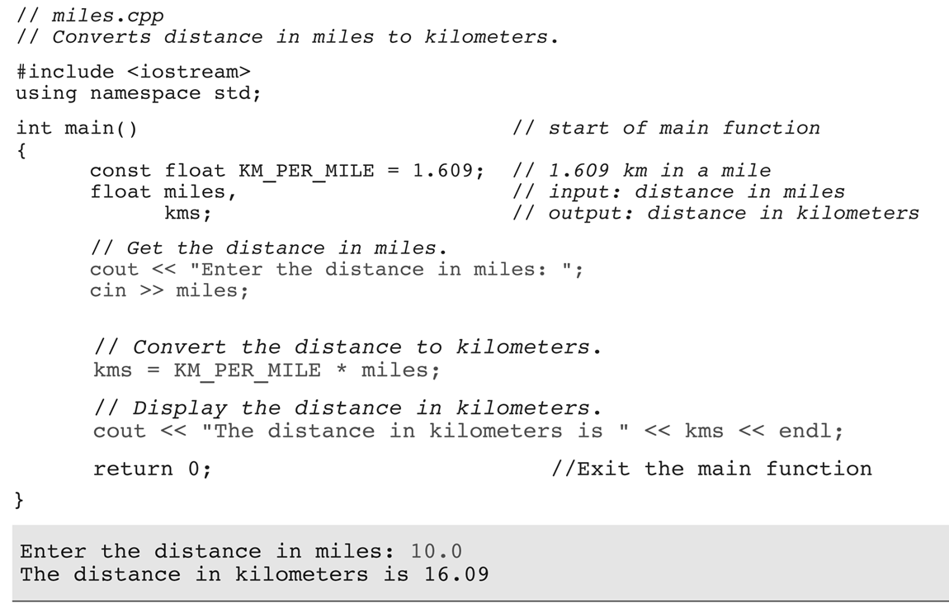
Source Code Explanation

Slide 30
Testing
Test the program with input data for which you can easily determine the correct output.
For example:
  10 miles should be converted to 16.09 kilometers

Slide 31
Questions?
Q & A

